Slide 1
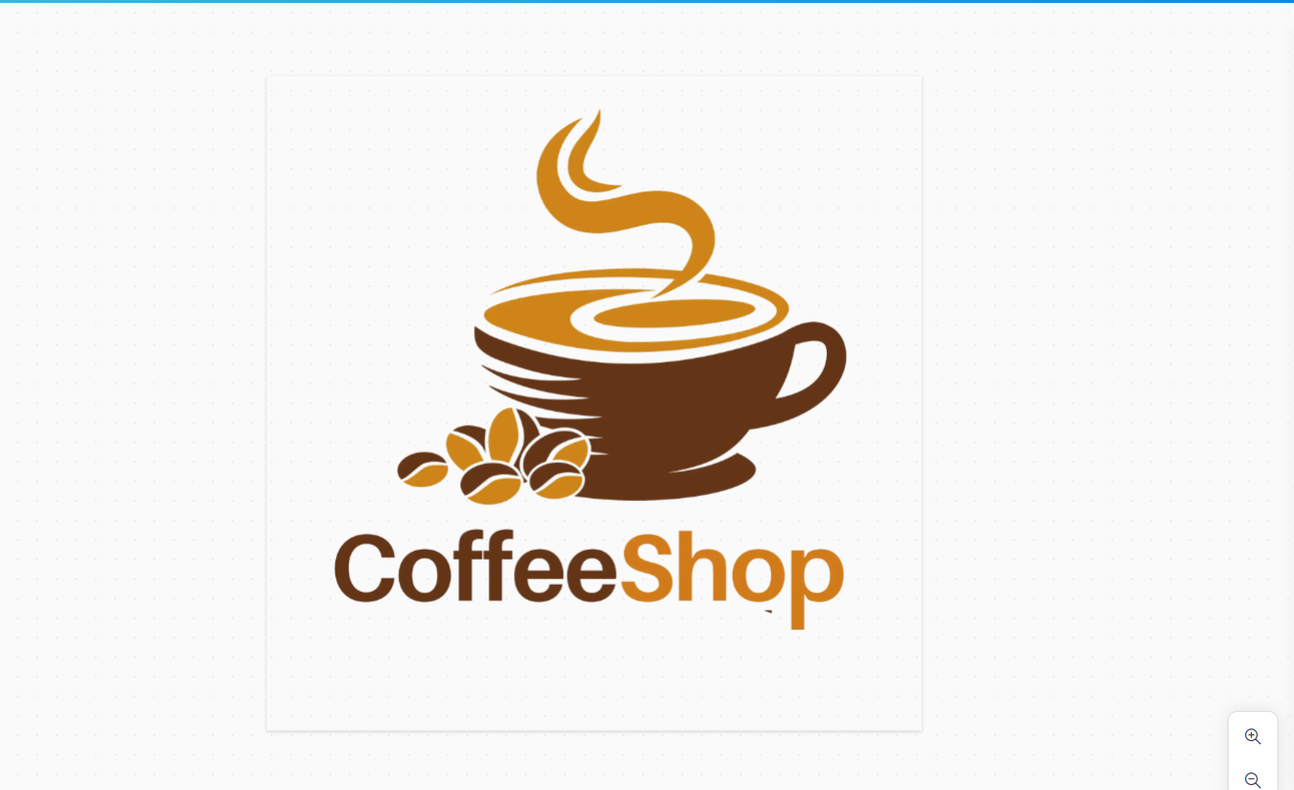

Bright Coffee Shop
Tendani Netshiendeulu course: Data Science

Slide 2
Coffee Shop Data Analysis For The CEO
CONTENT
INTRODUCTION
DATA SYSTEMS
ANALYSIS
RECOMMENDATION
Q&A

Slide 3
Introduction
The new CEO mission is to grow the company’s revenue and improve product, my task as a data scientist is to extract actionable insights from historical data to help him improve revenue and product performance within the stores.

Slide 4
Data Systems
Project Planning
Miro
Canva
Data Processing
Databricks
Data Visualisation
Microsoft Excel
Presentation & Reporting
Microsoft PowerPoint

Slide 5
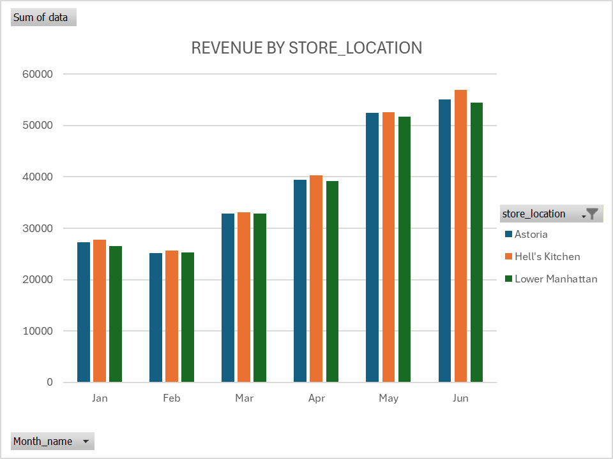
Analysis
Insights
-The is an increase in revenue from January to June for 6 month in both the three stores.
-Hell’s Kitchen store is one with the highest revenue
-Astoria is the middle store, while lower Manhattan is the one with the lowest revenue of all three stores
-both stores perfume well from May to June during winter seasons

Slide 6
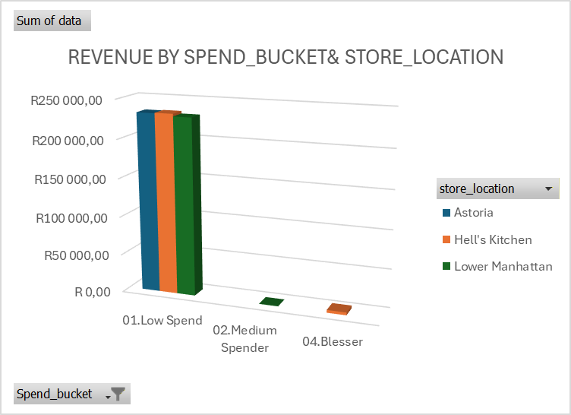
Analysis
Insights
-01. Low Spend bucket contributes most of total revenue across in all three stores
- The store perform similarly in all three stores in revenue with Hell’s Kitchen being the leader and Lower Manhattan being the second

Slide 7
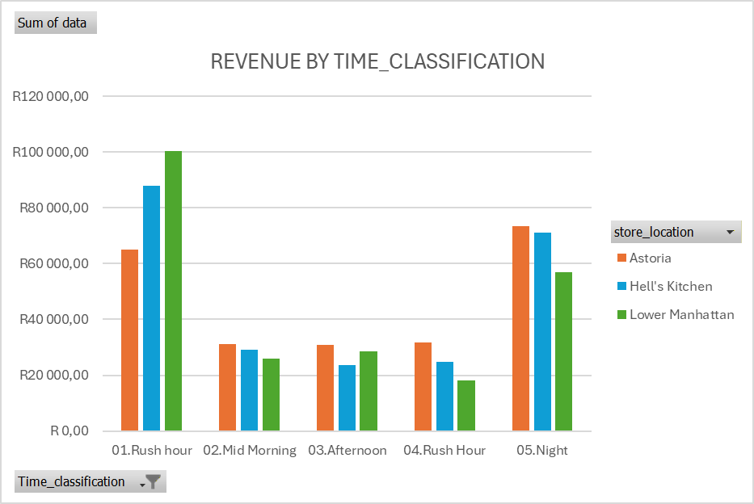
Analysis
Insights
-01. rush hour period is the one with the highest revenue in all three stores and lower Manhattan showing high performance during early rush hour
-05. which is night time is the second time where revenue increases in all three stores
- During Mid-morning & afternoon both stores underperform, it’s the period with the lowest revenue generator

Slide 8
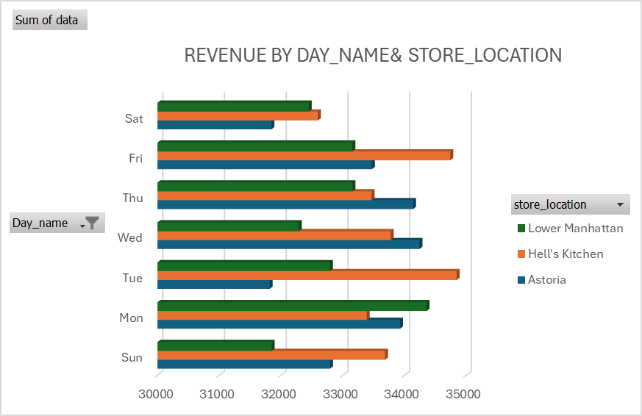
Analysis
Insights
-Hell’s Kitchen is the one that leading the most on Fri,Tue, Sun and also on Saturday
-Astoria doesn’t perfume well on Tue, Sat, Sun but revenue is high on Wed and Thu
-Lower Manhattan’s perfume very well on Mon

Slide 9
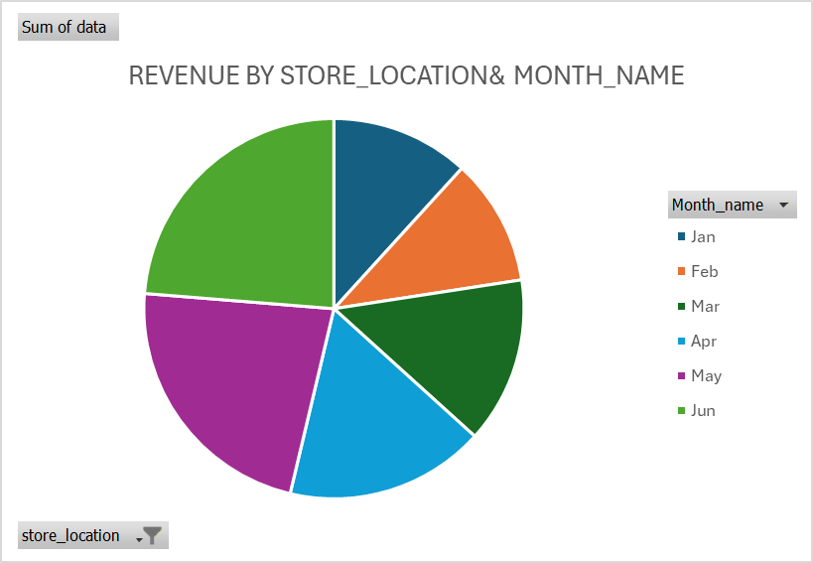
Analysis
Insights
-For all three stores Jan and feb are the months where they don’t make a lot of revenue
-Mar and Apr which are the mid period the is a transition phase from Jan and Feb which shows a rise in demand
-Peak months are May and Jun because of the change in season the demand is high

Slide 10
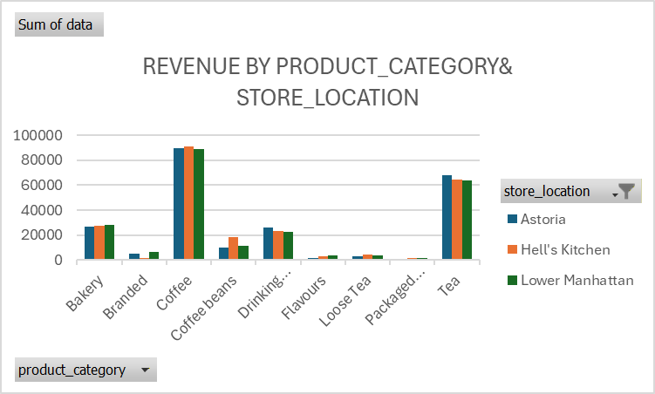
Analysis
Insights
-Coffee bring in more revenue than all the other products_category in all the stores, with tea being the second category that brings in more revenue
-Flavours, Loose Tea, Packaged and Branded product category are the ones that contribute less in terms of revenue
-Hell’s Kitchen when is comes to Coffee and Coffee Beans is the leading store

Slide 11
Recommendations
-Introduce promotions or discounts to lower manhattan store
-Introduce Seasonal campaigns for both lower manhattan and astoria
-Introduce bundles or combo deals to lower spend customers
-Focus on growing revenue during mid-morning & afternoon by introducing happy hour deals and Combo discounts
-Work on Astoria’s weak days on Tue, Sat, Sun by doing local promotions such as offering bundles
-Spend more on marketing during Feb to Apr to increase demand
-Increase basket size by offering Coffee and Bakery combos

Slide 12
Q&A
ANY QUESTIONS?

